Slide 1


Team CHAOS
AI-powered candidate ranking for large-scale hiring
Candidate Ranking System
Team Lead: Krishna Choudhary
Krishna Choudhary · Ritik Ahire · Anup Verma

Slide 2

The Challenge
Recruiter Overload at Scale
Key Problems
Hiring teams face an impossible task: evaluating thousands of profiles manually, missing top talent while wasting critical time.
100,000 candidate profiles to evaluate
Manual filtering slow and inefficient
Keyword matching misses good candidates
Fake/suspicious profiles present
Need accurate, explainable ranking
STATS
MANUAL SCREENING CAN TAKE 23 HOURS PER HIRE ON AVERAGE
OVER 75% OF QUALIFIED CANDIDATES ARE REJECTED BY KEYWORD FILTERS

Slide 3

Our Approach
AI-Powered Multi-Signal Ranking Pipeline
Combining rule-based intelligence with semantic understanding to evaluate candidates across multiple signals for accurate, explainable ranking at scale.
Pipeline Flow
Candidate Dataset → Feature Extraction
Skill Matching → Behavior Analysis
Semantic Similarity → Honeypot Detection → Final Ranking

Slide 4


Signals Used for Ranking
10 Key Features Powering AI Candidate Scoring
Each signal contributes a weighted score to the final candidate ranking, combining rule-based logic with semantic AI understanding.
SKILL MATCH · JOB TITLE · EXPERIENCE · EDUCATION · SEMANTIC AI · HONEYPOT DETECTION
Behavioral Signals
Recruiter response rate
Candidate activity level
GitHub activity
Location preference

Slide 5

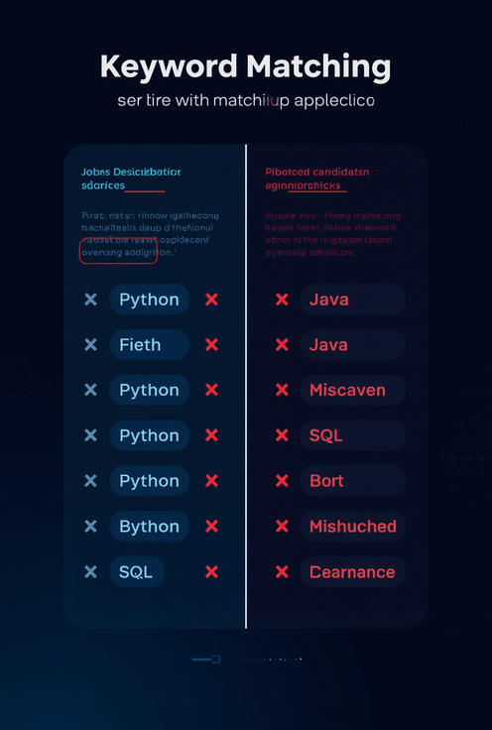
Beyond
Keywords
Semantic AI Layer
Model: Sentence Transformers (all-MiniLM-L6-v2) — understanding candidate meaning, not just keywords.
VS
KEYWORD MATCHING: RIGID, MISSES SYNONYMS, CONTEXT-BLIND
SEMANTIC UNDERSTANDING: CONCEPT CLUSTERS, DEEP CONTEXTUAL MATCH, HIGHER RECALL
Advantages
Understand candidate meaning, not keywords
Improve candidate-job matching accuracy
Capture hidden relevance & context

Slide 6
Performance Results
Key Metrics
Runtime: ~113 seconds
Top 100 candidates ranked
CPU compatible system
100K Candidates Processed
Redrob AI processed 100,000 candidate profiles end-to-end, generating a ranked shortlist with full explainability — running entirely on CPU hardware.
~113 SEC TOTAL RUNTIME
End-to-end pipeline benchmark

Slide 7


Project
Impact
Making candidate selection smarter, faster, and scalable.
✦ End-to-end working system
✦ Scalable to 100,000+ profiles
✦ Explainable AI rankings
✦ Detects suspicious profiles
✦ Works fully offline
www.redrob.ai
Team CHAOS

